Slide 1
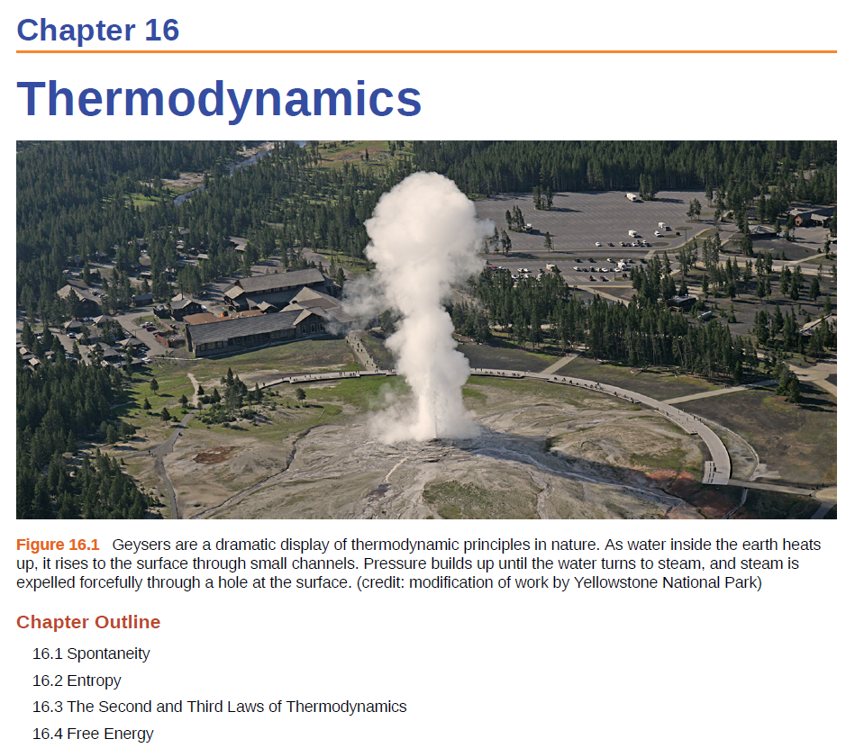

Gibbs Free Energy
Temperature and Spontaneity
Free Energy and Equilibrium
Thermodynamics of Living Systems

Slide 2
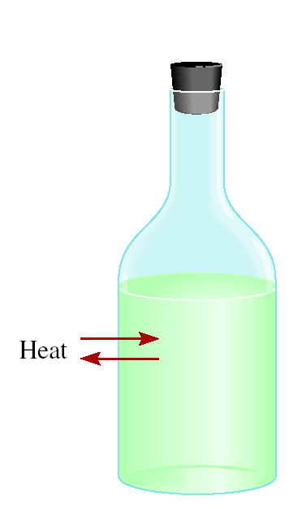
Thermodynamics
Second Law of Thermodynamics
The entropy of the universe increases in a spontaneous process and remains unchanged in an equilibrium process.
Spontaneous process:
ΔS_{univ} > 0
Equilibrium :
ΔS_{univ} = 0
surrounding
system
Nonspontaneous process:
ΔS_{univ} < 0
If something happens the total entropy of the universe increases!
All we need to know is ΔS_{univ}

Slide 3
Predicting Spontaneity
If we mix reactants and products together will the reaction occur?
Equilibrium :
ΔS_{univ} = 0
surrounding
Nonspontaneous process:
ΔS_{univ} < 0
system
Spontaneous process:
ΔS_{univ} > 0
If we know ΔS_{surr} we can calculate ΔS_{univ}
ΔS_{univ} = ΔS_{sys} + ΔS_{surr}
Can calculate from:
ΔS⁰
=
Σ
nS⁰(products)
-
Σ
mS⁰(reactants)
rxn

Slide 4
Predicting Spontaneity
If we know ΔS_{surr} we can calculate ΔS_{univ}
ΔS_{univ} = ΔS_{sys} + ΔS_{surr}
Can calculate from:
ΔS⁰
=
Σ
nS⁰(products)
-
Σ
mS⁰(reactants)
rxn
Surrounding = everything in the universe except the system.
surrounding
ΔS_{surr}
“Impossible” to measure!
system
ΔS⁰_{rxn}

Slide 5
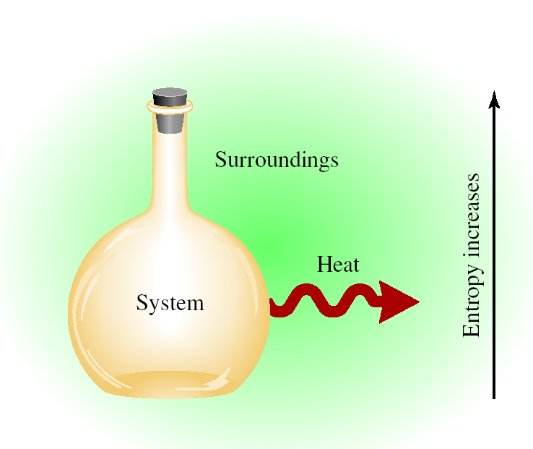
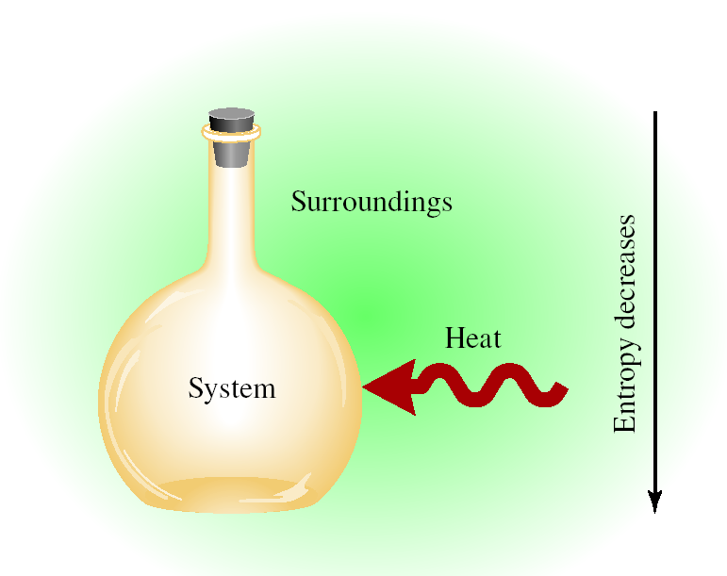
Heat and Entropy
Exothermic Reaction
Endothermic Process
−ΔH_{sys}
0 > ΔH_{sys}
+ΔH_{sys}
0 < ΔH_{sys}
Surroundings + heat = ↑ S
Surroundings - heat = ↓ S
ΔS_{surr} > 0
ΔS_{surr} < 0
ΔS_{surr} ∝ -ΔH_{sys}

Slide 6
Heat and Entropy
Heat released by the system increases the disorder of the surroundings.
ΔS_{surr} ∝ -ΔH_{sys}
The effect of -ΔH_{sys} on the surroundings depends on temperature:
  At high temperature, where there is already considerable disorder, the effect is muted
  At low temperature the effect is much more significant
  The difference between tossing a rock into a calm pool (low T) and a storm-tossed ocean (high T)
-ΔH_{sys}
ΔS_{surr} =
T

Slide 7
Predicting Spontaneity
ΔS_{univ} = ΔS_{sys} + ΔS_{surr}
-ΔH_{sys}
-ΔH_{sys}
ΔS_{surr} =
Substitution:
ΔS_{univ} = ΔS_{sys} +
T
T
Multiply by -T:
-TΔS_{univ} = -TΔS_{sys} + ΔH_{sys}
Rearrange:
-TΔS_{univ} = ΔH_{sys} - TΔS_{sys}
This equation relates ΔS_{univ} to ΔH_{sys} and ΔS_{sys}.
Both in terms of the system.

Slide 8
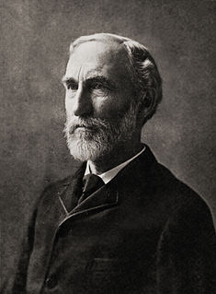
Gibbs Free Energy
-TΔS_{univ} = ΔH_{sys} - TΔS_{sys}
ΔG = ΔH_{sys} - TΔS_{sys}
Gibbs free energy (ΔG)-
AKA Free energy.
Relates S, H and T of a system.
Can be used to predict spontaneity.
G is a state function.
Josiah Willard Gibbs (1839-1903)
First American Ph.D. in Engineering (Yale, 1863)
Praised by Albert Einstein as "the greatest mind in American history"

Slide 9
Gibbs Free Energy
For a constant temperature and constant pressure process:
-TΔS_{univ} = ΔH_{sys} - TΔS_{sys}
ΔG = ΔH_{sys} - TΔS_{sys}
Gibbs free energy (ΔG)- Can be used to predict spontaneity.
ΔG < 0 The reaction is spontaneous in the forward direction.
−ΔG = -T(+ΔS_{univ})
ΔS_{univ} > 0
ΔG > 0 The reaction is nonspontaneous as written. The
reaction is spontaneous in the reverse direction.
+ΔG = -T(-ΔS_{univ})
ΔS_{univ} < 0
ΔG = 0 The reaction is at equilibrium.
ΔG = -T(-ΔS_{univ}) = 0
ΔS_{univ} = 0

Slide 10
Gibbs Free Energy
ΔG = ΔH - TΔS
If you know ΔG for reactants and products then you can calculate if a reaction is spontaneous.
If you know ΔG for two reaction then you can calculate if the sum is spontaneous.
If you know ΔS, ΔH and T then you can calculate spontaneity.
Can predict the temperature when a reaction becomes spontaneous.
If you have ΔH_{vap} or ΔH_{fus} and ΔS you can predict boiling and freezing points.
If you have ΔH_{vap} or ΔH_{fus} and T you can predict the entropy change during a phase change.
Can predict equilibrium shifts.

Slide 11
Standard Free Energy Changes
The standard free-energy of reaction (ΔG⁰ ) is the free-energy change for a reaction when it occurs under standard-state conditions.
rxn
aA + bB cC + dD
ΔG⁰
=
Σ
nΔG⁰ (products)
-
Σ
mΔG⁰ (reactants)
rxn
f
f
Standard free energy of formation (ΔG⁰) is the free-energy change that occurs when 1 mole of the compound is formed from its elements in their standard states.
f
ΔG⁰
cΔG⁰ (C)
dΔG⁰ (D)
-
aΔG⁰ (A)
bΔG⁰ (B)
=
[
+
]
[
+
]
rxn
f
f
f
f
ΔG⁰ of any element in its stable form is zero.
f

Slide 12
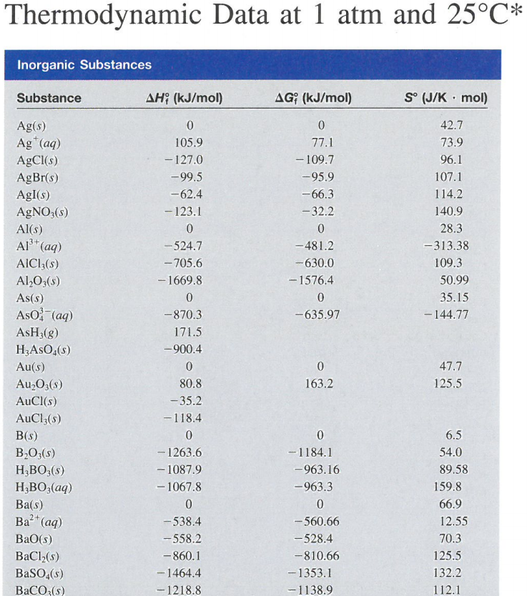
Standard Free Energy Changes
ΔG is a state function so free energy can be calculated from the table of standard values just as enthalpy and entropy changes.
aA + bB cC + dD
ΔG⁰
=
Σ
nΔG⁰ (products)
rxn
f
-
Σ
mΔG⁰ (reactants)
f
Standard free energy of formation (ΔG⁰) is the free-energy change that occurs when 1 mole of the compound is formed from its elements in their standard states.
f

Slide 13
ΔG° Calculations
Appendix 3
ΔG⁰
=
Σ
nΔG⁰ (products)
rxn
f
-
Σ
mΔG⁰ (reactants)
f
To predict spontaneity of any rxn:
Pick any reactants and products.
Write a balanced equation.
Calculate ΔG⁰_{rxn}.
Is the reaction spontaneous?

Slide 14
Standard Free Energy Changes
Calculate the standard free-energy change for the following reaction:
2KClO₃(s) → 2KCl(s) + 3O₂(g)
ΔG⁰
=
Σ
nΔG⁰ (products)
-
Σ
mΔG⁰ (reactants)
rxn
f
f
ΔG⁰_{rxn} = [2(−408.3 kJ/mol) + 3(0)] − [2(−289.9 kJ/mol)]
ΔG⁰_{rxn} = −816.6 − (−579.8)
From appendix 3:
ΔG⁰_{rxn} = −236.8 kJ/mol
KClO₃(s) ΔG°_{f} = -289.9 kJ/mol
KCl(s) ΔG°_{f} = -408.3 kJ/mol
O₂(g) ΔG°_{f} = 0 kJ/mol
Is the reaction spontaneous?
ΔG⁰_{rxn} < 0 Yes!

Slide 15
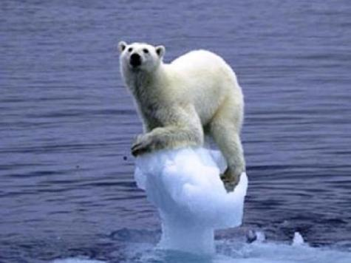
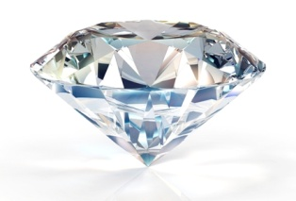
Another Example
C(s, diamond) + O₂(g) CO₂(g)
ΔG°_{rxn} = [ΔG°_{f} (CO₂)] - [ΔG°_{f} (C, diamond) + ΔG°_{f} (O₂)]
From appendix 3:
ΔG°_{rxn} = -397.3 kJ
C, diamond(s) ΔG°_{f} = 2.9 kJ/mol
O₂(g) ΔG°_{f} = 0 kJ/mol
CO₂(g) ΔG°_{f} = -394.4 kJ/mol
Is the reaction spontaneous?
+ O₂
Therefore, diamonds are contributing to climate change!
very slowly

Slide 16

More ΔG° Calculations
Similar to ΔH°, one can use the ΔG° for various reactions to determine ΔG° for the reaction of interest (a “Hess’ Law” for ΔG°)
Hess’ Law- states that regardless of the multiple stages or steps of a reaction, the total enthalpy change for the reaction is the sum of all changes.
What is the ΔG° for this reaction:
Given:
C(s, diamond) + O₂(g) CO₂(g) ΔG° = -397 kJ
C(s, graphite) + O₂(g) CO₂(g) ΔG° = -394 kJ

Slide 17
More ΔG° Calculations
What is the ΔG° for this reaction:
Given:
C(s, diamond) + O₂(g) CO₂(g) ΔG° = -397 kJ
C(s, graphite) + O₂(g) CO₂(g) ΔG° = -394 kJ
CO₂(g) C(s, graphite) + O₂(g) ΔG° = +394 kJ
C(s, diamond) + O₂(g) CO₂(g) ΔG° = -397 kJ
CO₂(g) C(s, graphite) + O₂(g) ΔG° = +394 kJ
C(s, diamond) C(s, graphite) ΔG° = -3 kJ
ΔG°_{rxn} < 0…..rxn is spontaneous

Slide 18
Alternative ΔG Calculation
Is the following reaction spontaneous at 298 K? (assume standard conditions)
Given:
 | ΔH°_{f} (kJ/mol) | S° (J/mol.K)
KClO₃(s) | -397.7 | 143.1
KClO₄(s) | -432.8 | 151.0
KCl (s) | -436.7 | 82.6
Given
ΔG°_{rxn} = ΔH°_{rxn} - TΔS°_{rxn}
Then Find
First Calculate

Slide 19
Alternative ΔG Calculation
 | ΔH°_{f} (kJ/mol) | S° (J/mol.K)
KClO₃(s) | -397.7 | 143.1
KClO₄(s) | -432.8 | 151.0
KCl (s) | -436.7 | 82.6

Slide 20
Alternative ΔG Calculation
 | ΔH°_{f} (kJ/mol) | S° (J/mol.K)
KClO₃(s) | -397.7 | 143.1
KClO₄(s) | -432.8 | 151.0
KCl (s) | -436.7 | 82.6
ΔH°_{rxn} = -144 kJ
ΔS°_{rxn} = -36.8 J/K
Enthalpically favorable
Entropically unfavorable
What about at 5000 K?
(Assuming the same ΔH and S)
ΔG°_{rxn} = 50 kJ
ΔG°_{rxn} > 0…rxn is nonspontaneous at 5000 K
ΔG°_{rxn} < 0…..rxn is spontaneous at 298 K

Slide 21
Gibbs Free Energy
Temperature and Spontaneity
Free Energy and Equilibrium
Thermodynamics of Living Systems

Slide 22
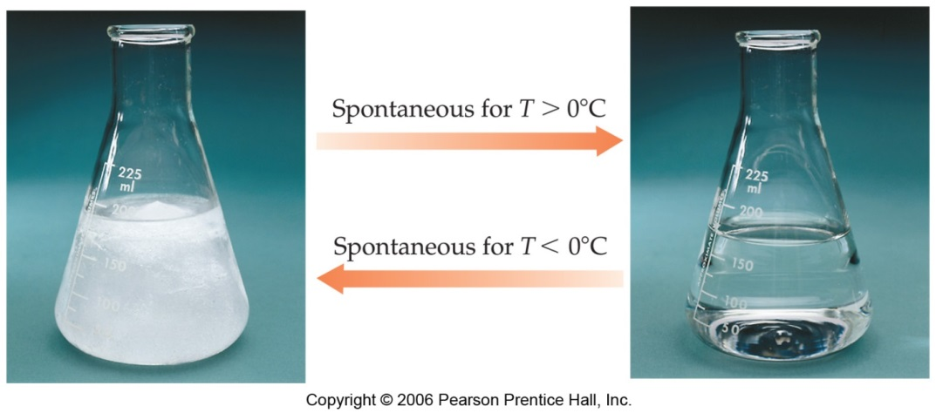
ΔG Temperature Dependence
ΔG°_{rxn} = -133 kJ at 298 K
Spontaneous
ΔG°_{rxn} = 50 kJ at 5000 K
Nonspontaneous
Reaction spontaneity is a temperature dependent phenomenon!
H₂O(s)
H₂O(l)
ΔG_{rxn} = ΔH_{rxn} - TΔS_{rxn}

Slide 23
ΔG Temperature Dependence
Enthalpy:
ΔH_{rxn} < 0 The reaction is enthalpically favorable.
Entropy:
ΔS_{rxn} > 0 The reaction is entropically favorable.
Need both to predict spontaneity. And sometimes temperature!
ΔG < 0 Spontaneous
ΔG = ΔH - TΔS
ΔG > 0 Nonspontaneous
ΔG = 0 Equilibrium
1) If ΔH < 0 and ΔS > 0, then ΔG is negative at all T
2) If ΔH > 0 and ΔS > 0, then ΔG depends on T
3) If ΔH < 0 and ΔS < 0, then ΔG depends on T
4) If ΔH > 0 and ΔS < 0, then ΔG is positive at all T

Slide 24
ΔG Temperature Dependence
ΔG < 0 Spontaneous
ΔG = ΔH - TΔS
ΔG > 0 Nonspontaneous
ΔG = 0 Equilibrium
3) ΔH < 0 and ΔS < 0
(Enthalpically favorable, entropically unfavorable)
If ΔH < TΔS, then ΔG is positive.
If ΔH > TΔS, then ΔG is negative.
Nonspontaneous at high T
Spontaneous at low T
(Enthalpically unfavorable, entropically favorable)
2) ΔH > 0 and ΔS > 0
If ΔH < TΔS, then ΔG is negative.
If ΔH > TΔS, then ΔG is positive.
Spontaneous at high T
Nonspontaneous at low T

Slide 25
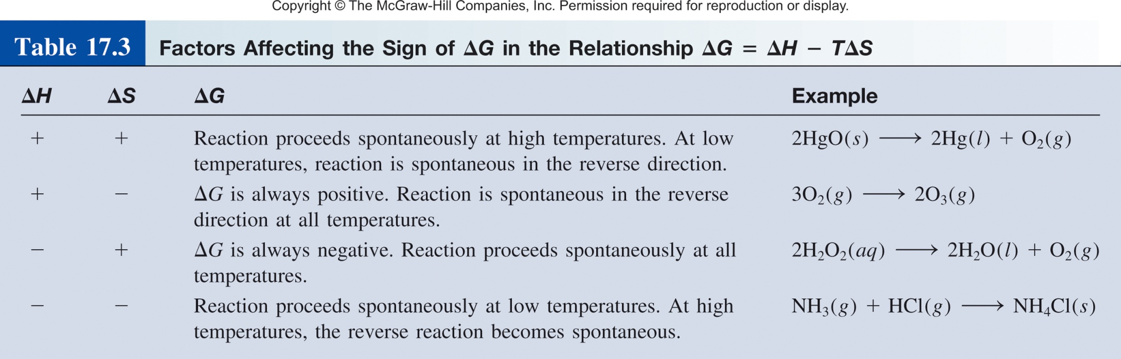
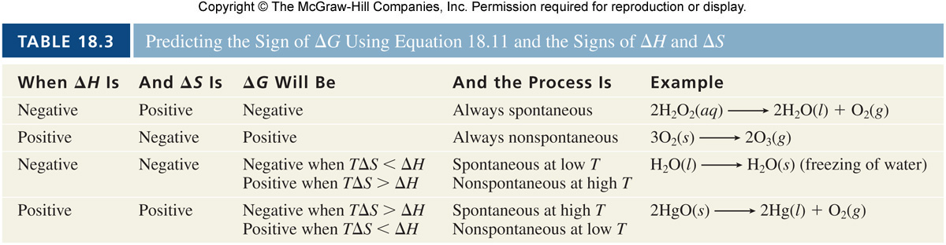
ΔG Temperature Dependence
ΔG = ΔH - TΔS

Slide 26
Predicting T from Gibbs Equation
ΔG°_{rxn} = -133 kJ at 298 K
Spontaneous
ΔG°_{rxn} = 50 kJ at 5000 K
Nonspontaneous
Reaction spontaneity is a temperature dependent phenomenon!
At what temperature will the reaction become spontaneous?
Find T where ΔG changes from positive to negative.
I.e. when ΔG =0.
ΔG = ΔH – TΔS = 0
T = ΔH/ΔS

Slide 27
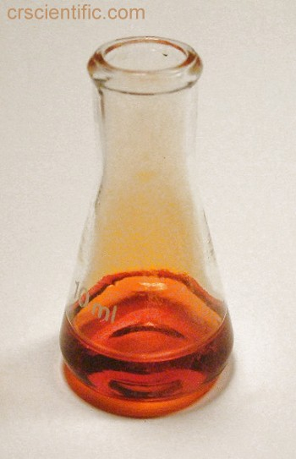
Predicting T from Gibbs Equation
At what T is the following reaction spontaneous?
Br₂(l) Br₂(g)
Given: ΔH°= 30.91 kJ/mol
ΔS°= 93.2 J/mol.K
ΔG = ΔH – TΔS = 0
T = ΔH/ΔS
  ΔH > 0, ΔS > 0
  The reaction will be spontaneous when T > 331.7 K
T = (30.91 kJ/mol) /(93.2 J/mol.K)
T = 331.7 K

Slide 28
Gibbs Free Energy
Temperature and Spontaneity
Free Energy and Equilibrium
Thermodynamics of Living Systems

Slide 29
Free Energy and Equilibrium
The standard free-energy of reaction (ΔG⁰ ) is the free-energy change for a reaction when it occurs under standard-state conditions.
rxn
aA + bB cC + dD
ΔG⁰
=
Σ
nΔG⁰ (products)
-
Σ
mΔG⁰ (reactants)
rxn
f
f
ΔG° < 0 favors products spontaneously
ΔG° > 0 favors reactants spontaneously
Does not tell you it will go to completion!
ΔG° _{fwd}
aA + bB cC + dD
ΔG° _{fwd} = -ΔG° _{rev}
ΔG° _{rev}
The value of ΔG° calculated under the standard conditions characterizes the “driving force” of the reaction towards equilibrium.

Slide 30
Free Energy and Equilibrium
ΔG° = -R T lnK
equilibrium constant
(K_{p}, K_{c}, K_{a}, K_{sp}, etc.)
standard free-energy
(kJ/mol)
gas constant
(8.314 J/Kmol)
temperature
(K)
Arguably most important equation in chemical thermodynamics!
It allows us to calculate the extent of a chemical reaction if its enthalpy and entropy changes are known.
The changes in enthalpy and entropy can be evaluated by measuring the variation of the equilibrium constant with temperature.
This relationship is only valid for the standard conditions, i.e. when the activities of all reactants and products are equal to 1.

Slide 31
Free Energy and Equilibrium
ΔG° = -R T lnK
R is constant so at a given temperature:
ΔG⁰(kJ)
K
Significance
200
9x10⁻³⁶
Essentially no forward reaction; reverse reaction goes to completion
100
3x10⁻¹⁸
50
2x10⁻⁹
10
2x10⁻²
1
7x10⁻¹
Forward and reverse reactions proceed to same extent
0
1
FORWARD REACTION
REVERSE REACTION
-1
1.5
-10
5x10¹
-50
6x10⁸
-100
3x10¹⁷
Forward reaction goes to completion; essentially no reverse reaction
-200
1x10³⁵

Slide 32
Using ΔG° and K
Using the table of standard free energies, calculate the equilibrium constant, K_{P}, for the following reaction at 25 °C.
2HCl(g) H₂(g) + Cl₂(g)
ΔG⁰
=
Σ
nΔG⁰ (products)
-
Σ
mΔG⁰ (reactants)
rxn
f
f
ΔG⁰_{rxn} = [1(0) + 1(0)] - [2(−95.3 kJ/mol)]
ΔG⁰_{rxn} = 190.6 kJ/mol
Non-spontaneous!
Favors reactants!
ΔG° = -R T ln K
From appendix 3:
H₂(g) ΔG°_{f} = 0 kJ/mol
Cl₂(s) ΔG°_{f} = 0 kJ/mol
HCl(g) ΔG°_{f} = -95.3 kJ/mol

Slide 33
Using ΔG° and K
Using the table of standard free energies, calculate the equilibrium constant, K_{P}, for the following reaction at 25 °C.
2HCl(g) H₂(g) + Cl₂(g)
ΔG⁰
=
Σ
nΔG⁰ (products)
-
Σ
mΔG⁰ (reactants)
rxn
f
f
ΔG⁰_{rxn} = [1(0) + 1(0)] - [2(−95.3 kJ/mol)]
ΔG⁰_{rxn} = 190.6 kJ/mol
Non-spontaneous!
Favors reactants!
ΔG° = -R T ln K
190.6 kJ/mol = − (8.314 J/K·mol)(25°C) ln K_{P}
correct units
190.6 kJ/mol = − (8.314 x 10⁻³ kJ/K·mol)(298 K) ln K_{P}
K_{P} = 3.98 x 10⁻³⁴
Favors reactants!

Slide 34
Free Energy and Equilibrium
ΔG° = -R T lnK
ΔG°
-
Rearrange:
ln K =
R T
ΔH - TΔS
Substitution:
-
ln K =
R T
ΔG = ΔH - TΔS
ΔH TΔS
-
Rearrange:
ln K =
+
R T
R T
ΔH
1
ΔS
( )
-
ln K =
+
R
T
R

Slide 35
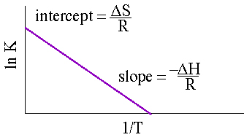
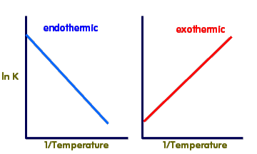
Free Energy and Equilibrium
ΔG° = -R T lnK
Measure equilibrium with respect to temperature:
ΔG°
-
Rearrange:
ln K =
R T
ΔH - TΔS
Substitution:
-
ln K =
R T
ΔG = ΔH - TΔS
ΔH TΔS
-
Rearrange:
ln K =
+
R T
R T
ΔH
1
ΔS
( )
-
ln K =
+
R
T
R
y = m • x + b

Slide 36
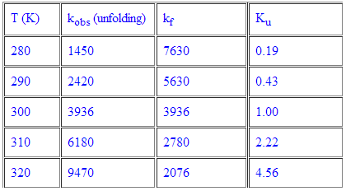

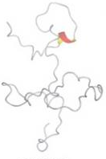
Free Energy and Equilibrium
Find the ΔS and ΔH of the following:
k_{obs}
k_{f}
A B
rate_{A→B} = k_{obs} [A]
rate_{B→A} = k_{f} [B]
At equilibrium:
rate_{A→B} = rate_{B→A}
k_{obs} [A] = k_{f} [B]
k_{obs}
[B]
=
=
K_{u}
k_{f}
[A]

Slide 37
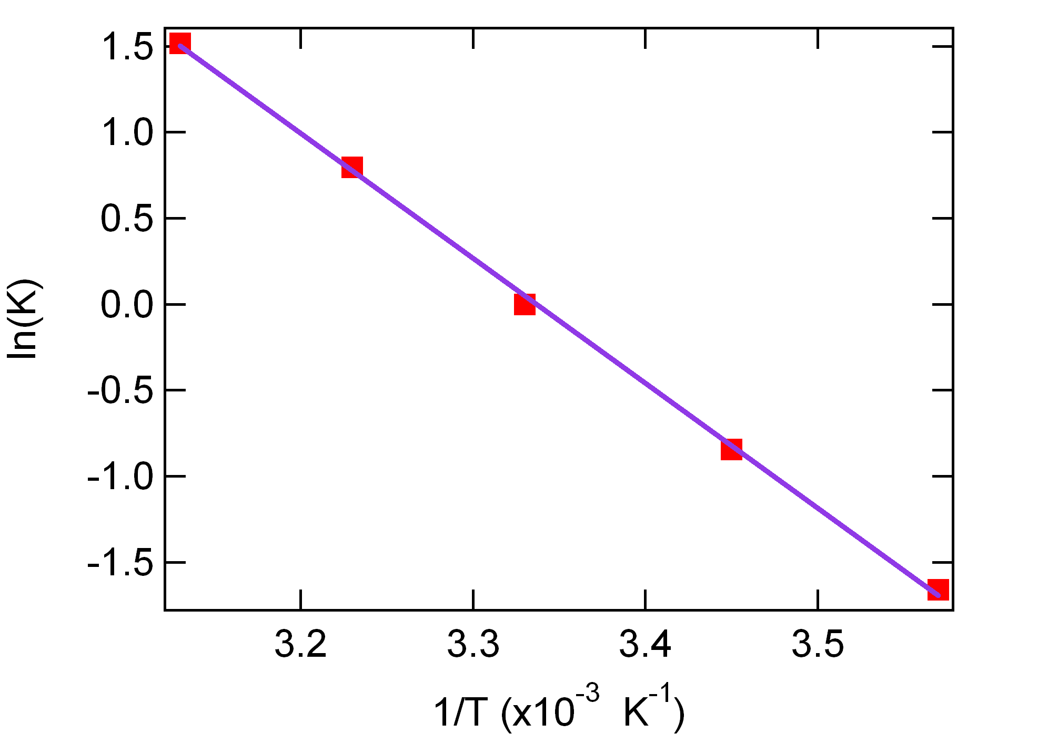
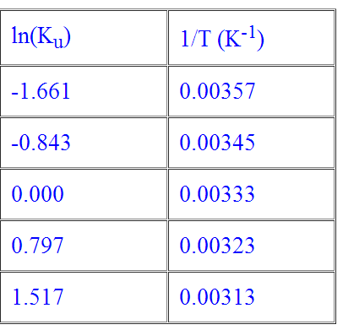
Free Energy and Equilibrium
Find the ΔS and ΔH of the following:
k_{obs}
k_{f}
ΔS
ΔH° = 60 kJ/mol
R
ΔS° = 200 J/Kmol
Slope = -7261.1 K
-
ΔH
R

Slide 38
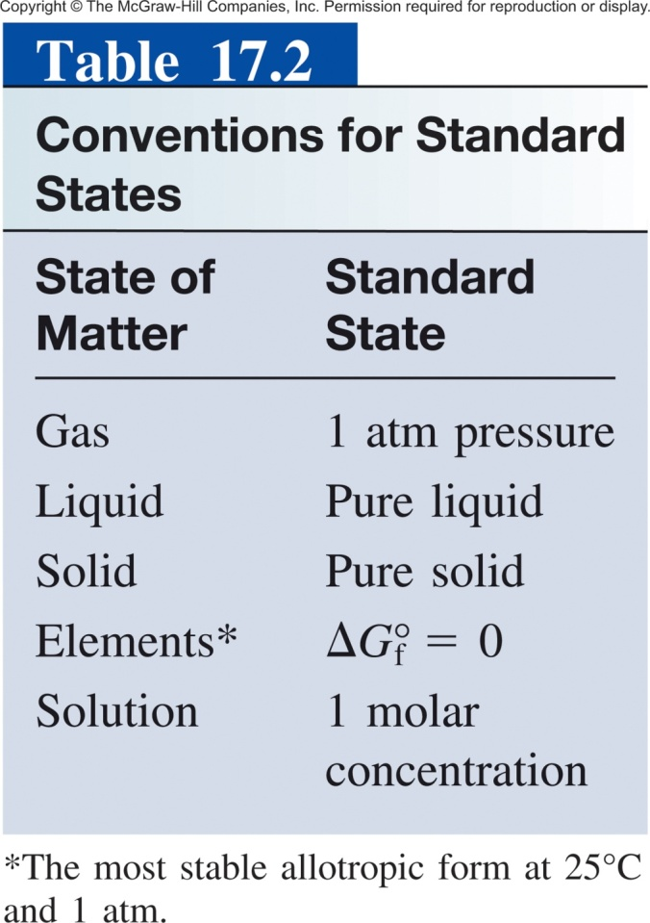
ΔG° vs ΔG
You have already delta ΔG°, ΔS° and ΔH° in which the ° indicates that all components are in their standard states.
Definition of “standard”:
Even if we start a reaction at standard conditions (1 M) the reaction will quickly deviate from standard.
ΔG° indicates whether reactants or products are favored at equilibrium.
ΔG at any give time is used to predict the direction shift to reach equilibrium.
If a mixture is not at equilibrium, the liberation of the excess Gibbs free energy (ΔG) is the “driving force” for the composition of the mixture to change until equilibrium is reached.
*There is no "standard temperature", but we usually use 298.15 K (25° C).

Slide 39
Free Energy and Equilibrium
At equilibrium:
ΔG° = -R T ln K
At any time:
ΔG = ΔG° + R T ln Q
reaction quotient
standard free-energy
(kJ/mol)
temperature
(K)
non-standard free-energy
(kJ/mol)
gas constant
(8.314 J/Kmol)
The sign of ΔG tells us that the reaction would have to shift to the left to reach equilibrium.
ΔG < 0, reaction will shift right
ΔG > 0, reaction will shift left
ΔG = 0, the reaction is at equilibrium
The magnitude of ΔG tells us how far it has to go to reach equilibrium.

Slide 40
Free Energy and Equilibrium
ΔG = ΔG° + R T ln Q
reaction quotient
standard free-energy
(kJ/mol)
temperature
(K)
non-standard free-energy
(kJ/mol)
gas constant
(8.314 J/Kmol)
If Q/K < 1, then ln Q/K < 0; the reaction proceeds to the right (ΔG < 0)
If Q/K > 1, then ln Q/K > 0; the reaction proceeds to the left (ΔG > 0)
If Q/K = 1, then ln Q/K = 0; the reaction is at equilibrium (ΔG = 0)

Slide 41
Another Example
For the following reaction at 298 K:
H₂(g) + Cl₂(g) → 2 HCl(g)
Given:
From appendix 3:
H₂ = 0.25 atm
Cl₂ = 0.45 atm
HCl = 0.30 atm
H₂(g) ΔG°_{f} = 0 kJ/mol
Cl₂(s) ΔG°_{f} = 0 kJ/mol
HCl(g) ΔG°_{f} = -95.3 kJ/mol
Which way will the reaction shift to reach equilibrium?
ΔG = ΔG° + R T ln Q
constant
calculate
calculate
given

Slide 42
Another Example
For the following reaction at 298 K:
H₂(g) + Cl₂(g) → 2 HCl(g)
Given:
From appendix 3:
H₂ = 0.25 atm
Cl₂ = 0.45 atm
HCl = 0.30 atm
H₂(g) ΔG°_{f} = 0 kJ/mol
Cl₂(s) ΔG°_{f} = 0 kJ/mol
HCl(g) ΔG°_{f} = -95.3 kJ/mol
Which way will the reaction shift to reach equilibrium?
ΔG = ΔG° + R T ln Q
ΔG° = [2(−95.27 kJ/mol)] − [0 + 0]
= −190.54 kJ/mol

Slide 43
Another Example
For the following reaction at 298 K:
H₂(g) + Cl₂(g) → 2 HCl(g)
Given:
From appendix 3:
H₂ = 0.25 atm
Cl₂ = 0.45 atm
HCl = 0.30 atm
H₂(g) ΔG°_{f} = 0 kJ/mol
Cl₂(s) ΔG°_{f} = 0 kJ/mol
HCl(g) ΔG°_{f} = -95.3 kJ/mol
Which way will the reaction shift to reach equilibrium?
ΔG = ΔG° + R T ln Q
ΔG° = −190.54 kJ/mol
Q = 0.80
constant
given
ΔG = −190,540 J/mol + (8.314J/K·mol)(298 K) ln (0.80)
ΔG = −191.09 kJ/mol
Because ΔG < 0, the net reaction proceeds from left to right to reach equilibrium.

Slide 44
Gibbs Free Energy
Temperature and Spontaneity
Free Energy and Equilibrium
Thermodynamics of Living Systems

Slide 45
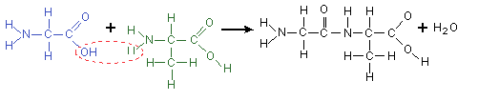
“Uphill” Reactions
Synthesis of proteins: (first step)
alanine + glycine → alanylglycine ΔG° = 29 kJ/mol
Because ΔG > 0, the reaction is non-spontaneous.
alanine
No reaction!
glycine
Need to couple two reactions!

Slide 46
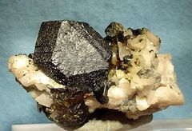
Coupled Reactions
Coupled Reactions- using a thermodynamically favorable reaction (ΔG° < 0) to drive an unfavorable one (ΔG° > 0) .
Example: Industrial ore separation-
Zinc Metal
Major applications in the US
Galvanizing (55%)
Alloys (21%)
Brass and bronze (16%)
Miscellaneous (8%)
Sphalerite ore
White pigment (ZnO)
Fire retardant (ZnCl₂)
Vitamin supplement (Zn²⁺)
Reducing agent (Zn(s))
We need 2000 tones of the zinc metal per year!

Slide 47

Coupled Reactions
Coupled Reactions- using a thermodynamically favorable (ΔG° < 0) reaction (ΔG° < 0) to drive an unfavorable one (ΔG° > 0) .
Example: Industrial ore separation-
Unfavorable reaction (ΔG° > 0)
95 % of Zinc is produced by this method

Slide 48
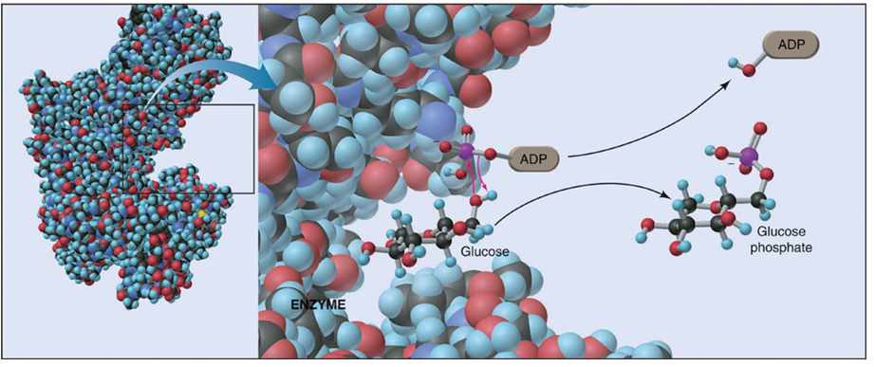
Coupled Reactions in Biology
ΔG° < 0
ΔG° > 0
glucose + Pi → glucose-6-phosphate
ATP + H₂O → ADP + Pi
glucose + ATP → glucose-6-phosphate + ADP

Slide 49
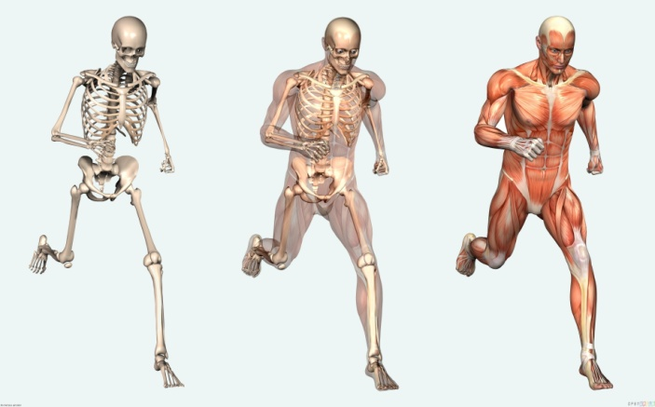
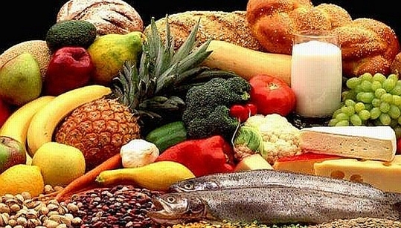
Coupled Reactions in Biology
?
Food
Structural motion and maintenance
Fats and Carbohydrates
Coupled reactions
ATP and NADPH
Chemical Batteries for the Body
Stored bond energy

Slide 50
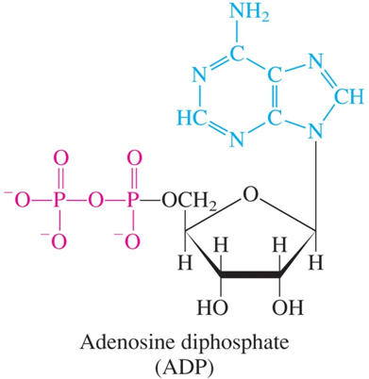
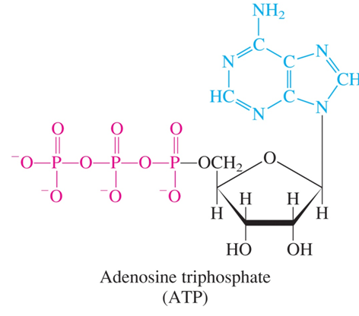
Coupled Reactions in Biology
Digestion/respiration:
Generation of ATP:
Burning Glucose
Low Energy
Higher Energy

Slide 51
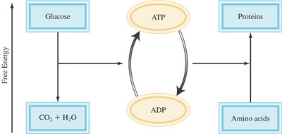
“Uphill” Reactions
Synthesis of proteins: (first step)
alanine + glycine → alanylglycine ΔG° = 29 kJ/mol
ATP + H₂O → ADP + H₃PO₄ ΔG° = -31 kJ/mol
alanine + glycine + ATP + H₂O → alanylglycine + ADP + H₃PO₄ ΔG° = -2 kJ/mol
Spontaneous!

Slide 52
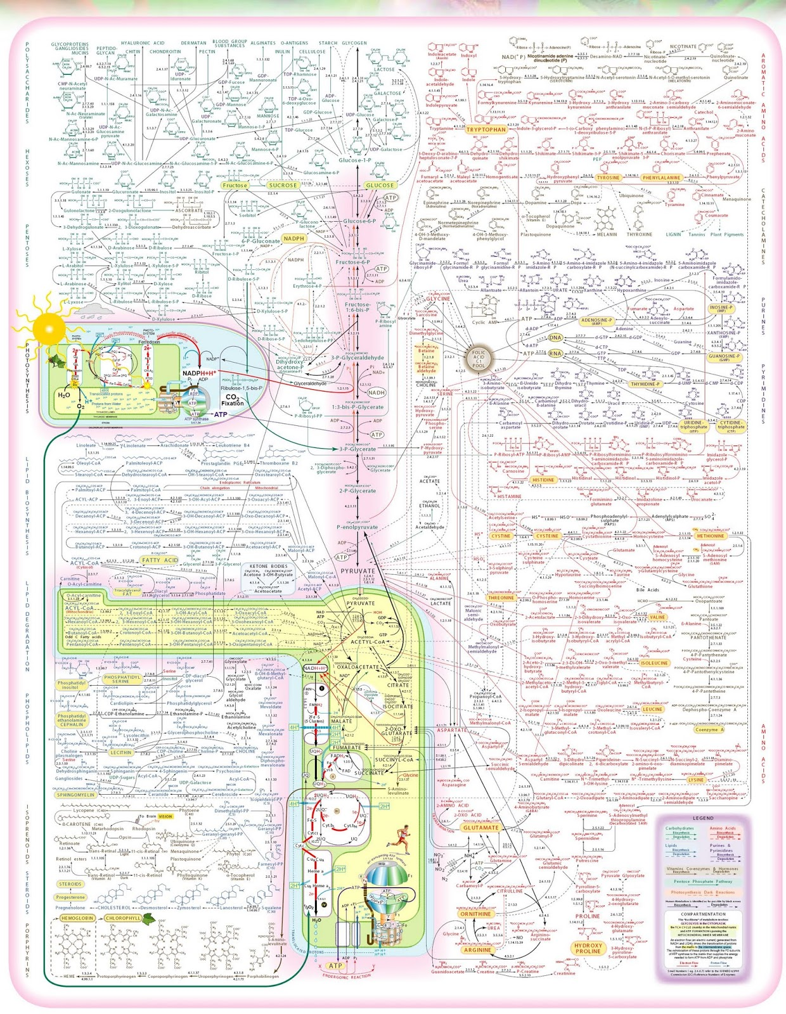
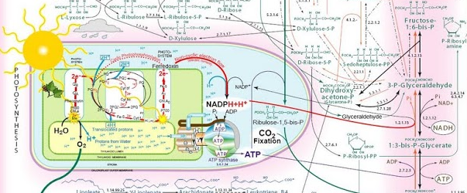
Coupled reactions to drive the synthesis of:
Aminoacids
Ribose
Nucleic acids
Polypeptides
DNA
Phospholipids
This is why we eat!
…and why plants absorb light.

